Slide 1
Storytelling with Data: Telecommunications Churn

Slide 2
GOAL/MOTIVATION
1
2
3
Recognize the number of clients who leave every quarter.
Determine who the company's most profitable clients are.
Suggestions for client retention, as well as why international expansion is a surefire way to increase revenue.

Slide 3
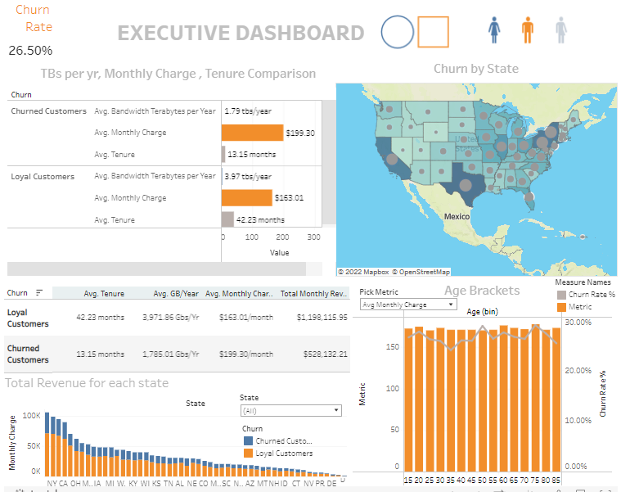
The churn rate at our company is 26.58% Telecommunications firms have annual turnover rates ranging from 10% to 67 %
Interactive Dashboard

Slide 4
KEY RESULTS:
1
2
3
I delved a little further and discovered the difference between disgruntled and loyal customers.
Customers will pay a higher price, but only for a limited period.
Previously, we used Python to delve deeper into our statistical research.

Slide 5
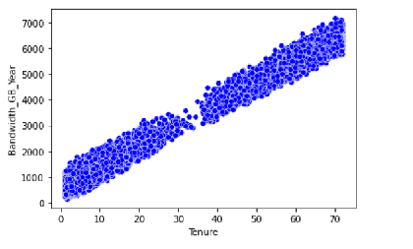

Slide 6
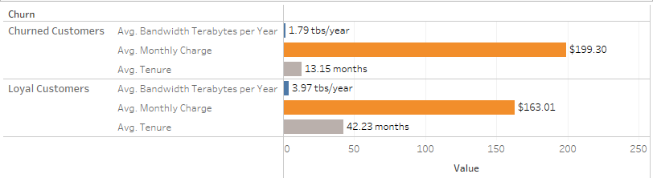
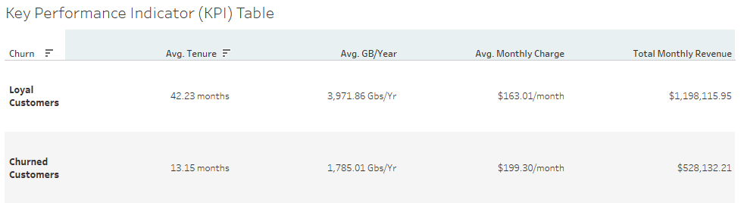

Slide 7
ACTIONAL INSIGHTS
A churned account's average monthly bill is $199, whereas a kept account's average monthly bill is $163.
It could be appropriate for companies to give incentives to consumers reaching the $190 mark, as acquiring new customers is pricier than retaining existing ones.
The relationship between average tenure in months and bandwidth in GBs per year is positive. When one rises, the other rises with it. Loyal clients have an average tenure of 42.23 months, while churned consumers have an average tenure of only 13 months (which makes complete sense). Bandwidth needs to be expanded – establishing AWS or Google Cloud into the company’s business model will suit well both the customers and the stakeholders.
THE LONGER A CONSUMER SPENDS TIME UTILIZING DATA, THE HIGHER THE CHANCE THE BANDWIDTH LIMITS WILL BE RAISED.
Perhaps provide greater discounts and lower monthly bills for churned or at-risk churned clients for at least three more years for the customers to return and the company to earn their loyalty.

Slide 8
